Slide 1

MNIST Image Classification with Data Augmentation

Slide 2
Team Members
1- Mohamed Elsayed Atwan
2-Abdelsalam Osman
3-Elsadek Hashem

Slide 3

Dataset
MNIST dataset, a collection of 28x28 grayscale images of handwritten digits (0-9).
Consists of 60,000 training images, and 10,000 test images.

Slide 4
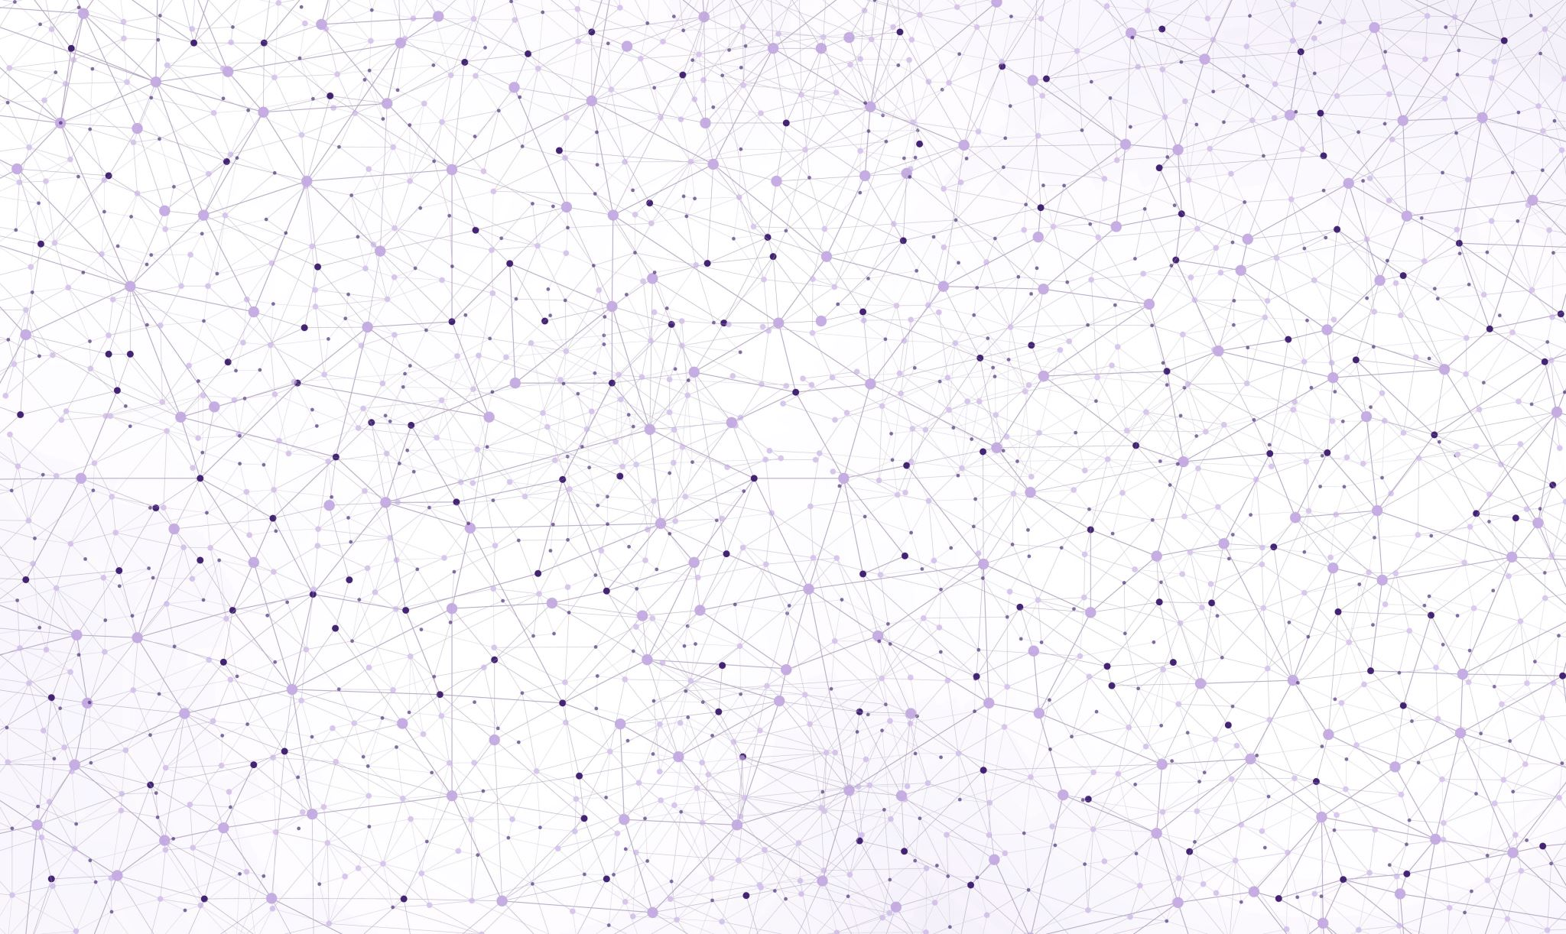
Data Preprocessing
Reshape and normalize the input images to a range of [0, 1].
Apply one-hot encoding to the labels for categorical classification.

Slide 5
Data Augmentation
Implement data augmentation using the ImageDataGenerator from Keras.
Augment training images with rotations, shifts, shearing, and zooming to increase dataset diversity.

Slide 6
Model Architecture
Construct a Convolutional Neural Network (CNN) using TensorFlow and Keras.
Design the architecture with three Conv2D layers and ReLU activation for feature extraction.
Utilize max-pooling to down-sample spatial dimensions.
Flatten the output and add Dense layers for classification.
Use softmax activation in the output layer for multi-class classification.

Slide 7
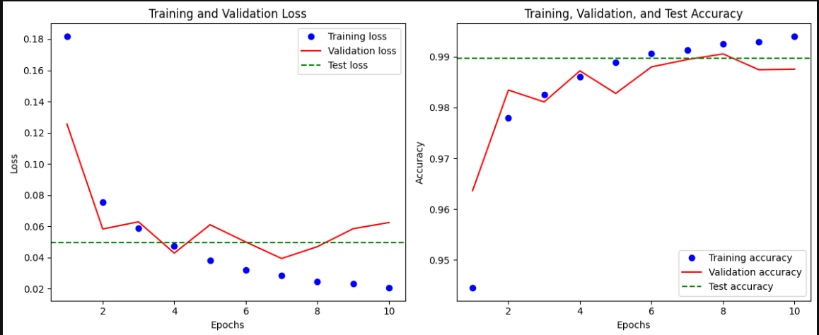
Evaluation Model

Slide 8
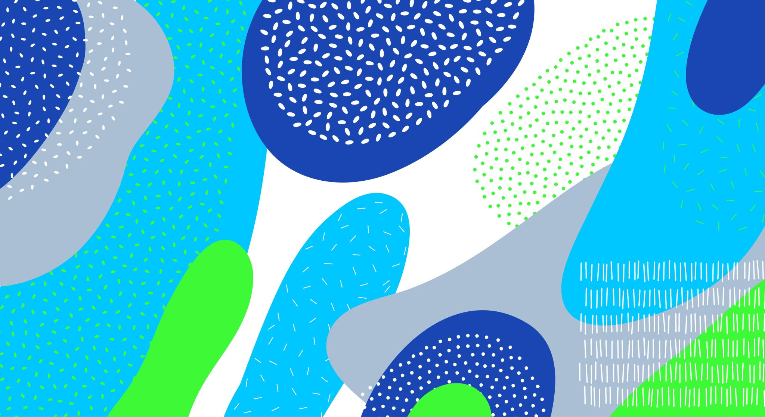
THANK YOU
Done By Abdelsalam Osama

